Slide 1


2021 Medicare Advantage Plans
Y0001_6013_21105_2021_M
72.35.784.1-SCPEP
©2020 Aetna Inc.

Slide 2

Understanding Medicare
Notes:
{VO:} Let’s begin with understanding Medicare

Slide 3
The basics of Medicare
Important terms for understanding your insurance coverage
Premium
Deductible
Copayment
Coinsurance
The monthly amount you pay for your Medicare coverage (you could have multiple premiums).
The amount you must pay for covered health care services before your insurance plan starts to pay.
The set amount you may have to pay as your share of the cost of covered medical services, supplies or prescription drugs (usually a dollar amount). If applicable, this amount is paid after you reach your deductible.
The amount you may have to pay as your share of the cost of covered medical services, supplies or prescription drugs (usually a percentage). If applicable, this amount is paid after you reach your deductible.
Notes:
{VO:} There are a few important terms you need to know to understand your Medicare coverage.
A premium is a fixed monthly amount that pays for your insurance coverage. Your part B premium is deducted from your Social Security check. However, if you sign up for different coverage options, you may be required to pay additional premiums.
Your deductible is the amount you are responsible to pay for covered health care services before your insurance plan starts to pay.
A copayment, also known as copay, is the amount you may have to pay as your share of the total cost for a medical service or supplies. This includes doctor visits, hospital outpatient visits or prescription drugs. A copayment is a set amount, not a percentage. For example, you might pay $10 or $20 for a doctor’s visit or a prescription drug.
Coinsurance is an amount you may be required to pay as your share of the cost for services or prescription drugs, after your reach your deductible. Coinsurance is usually a percentage (for example, 20%).
If applicable, the copayment or coinsurance is paid after you reach your deductible.

Slide 4
The four parts of Medicare
Government programs
(Original Medicare)
Private medical plans
Private drug plans
A
B
C
D
Hospital care
Medical care
You pay a premium
Medicare
Advantage
Medicare prescription drug plan (PDP)
Inpatient care
in hospitals
Skilled nursing facility care
Hospice care
Home health care
Services from doctors
and other health care providers
Outpatient and
home health care
Durable medical
equipment
Some preventive
services
Includes Part A and Part B benefits and services
Can include Medicare
PDP (Part D)
May add extra benefits
and services
Run by Medicare-approved, private insurance companies
Helps cover the
cost of prescription drugs
Helps protect against higher
costs in the future
Run by Medicare-approved, private insurance companies
Notes:
{VO:} Medicare can be complicated. Let’s simplify it by learning about the four parts of Medicare: A, B, C and D.
Government programs, or Original Medicare, include Part A and Part B. Part A, your Hospital care, covers things like inpatient care in hospitals, skilled nursing facility care, hospice care, and home health care. Part B is your Medical care and may require a premium. It covers services from doctors and other health care providers, outpatient and home health care, durable medical equipment, and even some preventive services
Part C are private medical plans, sometimes referred to as Medicare Advantage, and are run by private insurance companies. These include Part A and Part B benefits and often other services as well. Some Part C plans include Medicare Part D, which is for prescription drug coverage. Enrolling in Part D gives you access to some extra benefits and services, like full or partial coverage for the cost of prescription drugs and may help protect against higher costs in the future.

Slide 5

Understanding
Medicare Advantage
Notes:
{VO:} Now let’s learn about Medicare Advantage

Slide 6
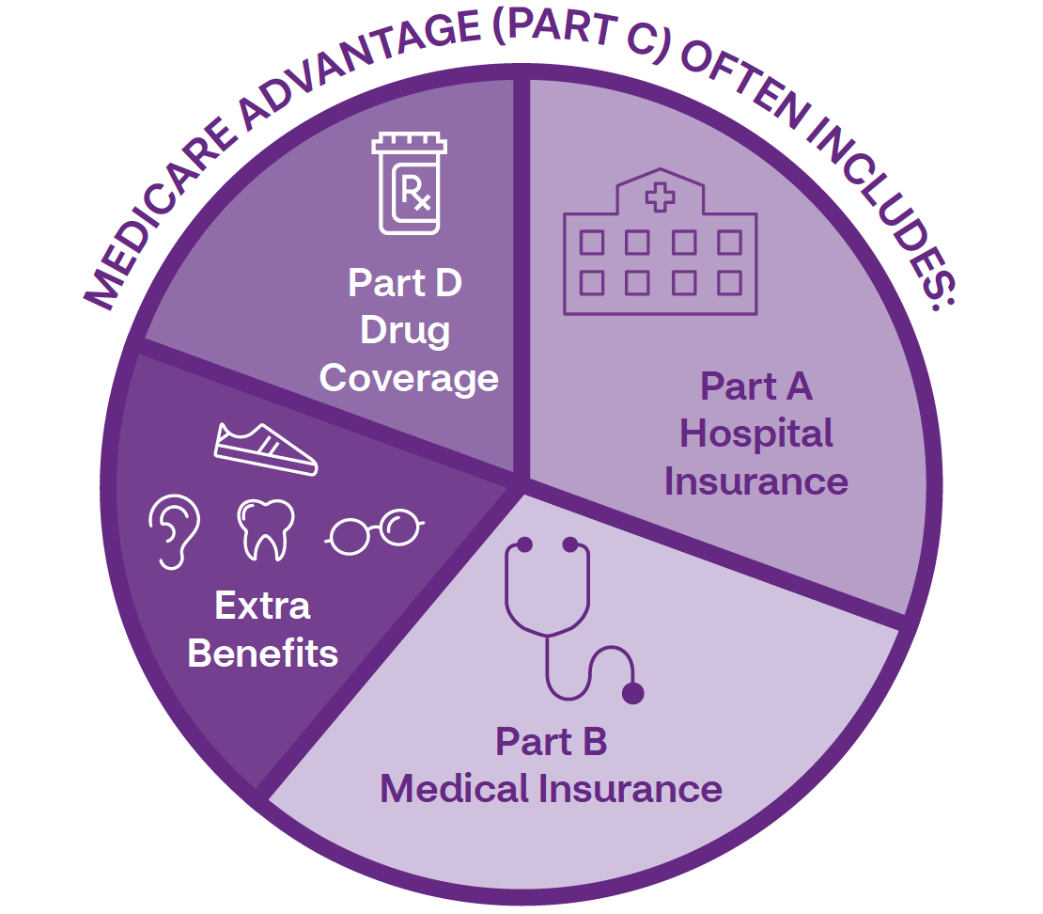
What is
Medicare Advantage?
It’s simple, all-in-one coverage from a private, Medicare-approved company.
Note: Medicare Advantage plans aren’t Medigap (Medicare Supplement) plans. Medigap plans fill in the gaps of Original Medicare.
Many insurance companies combine prescription drug coverage and medical coverage in their plans.
Notes:
{VO:} Medicare Advantage is a lot like Original Medicare, but often with more benefits. Medicare Advantage plans typically cover things that Original Medicare (Parts A and B) doesn’t — like dental, hearing and vision care and fitness memberships. Many insurance companies also combine prescription drug coverage (Medicare Part D) and medical coverage in their plans.

Slide 7

Our approach
We deliver a total and connected approach to health that enhances peoples’ lives every day. We:
Use technology and data to help you manage your health care experience and make care more connected and personal for you
Provide reminders and suggestions for medical appointments and other next steps to help keep you on a path to better health
Use advanced data and tools to help members
We also:
Help members to find and access community health resources
Help members navigate the health care system
Create a seamless health experience by connecting you to care in-person, over-the-phone or online
Notes:
{VO:} At Aetna, we have a unique approach to health. We offer Medicare Advantage plans that connect you with the doctors, pharmacists, and health and wellness providers involved in your care to help ensure a more personalized approach to your health. We deliver a total and connected approach to health by using technology and data to help you manage your health care experience and make care more connected and personal for you, providing reminders and suggestions for medical appointments and other next steps to help keep you on a path to better health, using advanced data and tools to help members, helping members to find and access community health resources, helping members navigate the health care system, and creating a seamless health experience by connecting you to care in-person, over-the-phone or online.

Slide 8
Types of Medicare Advantage (MA) plans
There are several types of MA plans. Here are three we may offer in your area.
HMO
    HMO-POS
PPO
A health maintenance organization
    A health maintenance organization with a point
    of service
A preferred provider organization
You’ll use doctors in
the plan’s network.
    You may need a referral
    to see a specialist.
    You’ll use doctors in the plan’s network.
    You may also go out of the network for certain covered services, but often for a higher copay or coinsurance. You may need a referral, too.
    You can use doctors
    and hospitals out of the network, but often for
    a higher cost.
    In most cases, you don’t need a referral to see a specialist.
Notes:
{VO:} There are different types of Medicare Advantage (MA) plans. Let’s learn about the three that Aetna may offer in your area.
If you choose a Health Maintenance Organization plan or HMO, you’ll use doctors in the plan’s network. You might need a referral to see a specialist.
With a Health Maintenance Organization with a Point of Service plan or HMO-POS, you’ll also use doctors in the plan’s network. You may go out of the network for certain services, but often for a higher copay or co-insurance, and going out of network may require a referral from your primary care physician.
A Preferred Provider Organization plan or PPO lets you use doctors and hospitals out of the plan’s network, but often for a higher out of pocket cost. In most cases, you do not need a referral to see a specialist.

Slide 9

Understanding
Medicare Part D
Notes:
{VO:} Let’s learn about Medicare Part D

Slide 10
Important terms for understanding your prescription drug benefits
Formulary
Tier
Network
Transition process
A list of drugs covered
by your plan.
A group of drugs in a formulary. Each tier requires a different level of payment. Higher tiers usually have higher cost sharing.
The pharmacy options you have for getting your prescription drugs.
You may get a one-time fill of a drug that isn't covered in the formulary.
Notes:
{VO:} There are a few important terms to know so that you can understand your prescription drug benefits.
A formulary is a list of drugs covered by your plan.
A tier is a group of drugs on a formulary. Each group or tier requires a different level of payment. You might see the groups listed as generic drugs, brand-name drugs or preferred brand-name drugs. Higher tiers usually have higher cost sharing. For example, a drug on Tier 2 generally will cost more than a drug on Tier 1.
Your network is made up by the pharmacy options you have for getting your prescription drugs.
You may get a one-time fill of a drug that isn’t covered on the formulary. This is known as the Transition Process.

Slide 11
What you need to know about prescription drug coverage
Stage
1
Stage
2
Stage
3
Stage
4
Deductible
Initial coverage
Coverage gap
Catastrophic coverage
Until you’ve reached your deductible, you’ll pay the full discounted cost for your covered drugs. Some plans have a $0 deductible.
After you’ve reached your deductible, you’ll pay only part of the cost for your covered drugs.
After you and your plan have paid a total of $4,130, you’ll pay only part of the cost for your covered drugs until you reach $6,550.
Once you’ve paid $6,550, you’re out of the coverage gap. This means you’ll only pay a small amount for your covered drugs for the rest of the year.
See the Evidence of Coverage (EOC) for complete coverage information.
Notes:
{VO:} It’s important to understand the four stages of prescription drug coverage.
Stage 1 is the deductible stage. You will be in this stage until you have reached your deductible. In this stage, you’ll pay the full discounted costs of formulary drugs.
Stage 2 is the initial coverage stage. After you have reached your deductible, you’ll pay only part of the cost for your drugs in the form of a fixed amount. For example, $15.
Stage 3 is called the coverage gap, or sometimes the donut hole. You’ll enter this stage after your total yearly drug cost reaches $4,130. In this stage, you’ll pay a percentage of drug costs. For example, 10%.
Stage 4 is catastrophic coverage. Once you’re out of the coverage gap, you will only pay a small amount for covered drugs for the rest of the year.

Slide 12

Welcome to an incredible pharmacy network
We have more than 65,000 pharmacies in our network.
More than 23,500 offer preferred
cost sharing.
Find a full list of pharmacies near you in our online directory at AetnaMedicare.com
12
Notes:
{VO:} Now that we’ve covered the basics of prescription drug coverage, let us welcome you to an incredible pharmacy network.
With over 65,000 pharmacies in our network, filling your prescriptions is convenient. And more than 23,500 offer preferred cost-sharing to give you the lowest price possible for your drugs.
Finding a network pharmacy near you is simple with our online network directory at AetnaMedicare.com

Slide 13
Preferred pharmacies
Albertsons®
Bartell Drugs
Bi-Lo®
Brookshire Grocery
Coborns
Costco®
CVS Pharmacy
Dierbergs
Discount Drug Mart
Giant Eagle®
H-E-B®
Hy-Vee®
Kmart
Kroger®
Meijer®
Price Chopper
Publix®
Safeway
Save Mart
ShopRite
SUPERVALU Pharmacies
Thrifty White
Walmart
Wegmans
You’ll typically pay less when you get your drugs at one of these retail pharmacies. Our network includes many local independent pharmacies, too.
Notes:
{VO:} We want you to pay the lowest possible price for your drugs. You’ll typically pay less when you get your drugs at one of these retail pharmacies. With more than 20,000 preferred cost-sharing pharmacies, finding one is easy. Our network includes many local independent pharmacies, too.
If your plan includes preferred pharmacies, you could get extra savings at these locations.
The pharmacy networks may be different on our prescription drug plans. Ask a licensed Aetna agent to learn more about your Part D plan options.

Slide 14

Important formulary tips
You can view our formularies at
AetnaMedicare.com
Sometimes our formularies change
Be sure to verify your medicines and their tiers when filling or refilling prescriptions.
Call 1-855-338-7027 (TTY:711) 24/7 to get more formulary information.
Notes:
{VO:} [Remember these important formulary tips.
It’s important to be familiar with our formulary and check it when signing up for a new prescription.
You can view our formularies at AetnaMedicare.com
Keep in mind, sometimes formularies can change.
For the latest information, visit our website or call us 24/7 at 1-855-338-7027 (TTY: 711) to get help with your formulary.

Slide 15
Your plan may also have these drug coverage rules:
    Prior authorization (PA)*
    Quantity limits (QLs)*
    Step therapy (ST)*
    Some drugs require prior authorization. Your doctor must first show a medical need for you to use the drug before the plan will cover it.
    These place a limit on how much of a drug you can get at one time.
    You must first try another drug on the plan’s formulary before you can move up a “step” to a higher tier drug.
    *The above rules are for safety purposes and to help keep your costs down. They were created with your health in mind.
Notes:
{VO:} [There are a few more things you may need to know. Your plan may also have these drug coverage rules:
Prior authorization (PA)
Some drugs require prior authorization. Your doctor must first show a medical need for you to use the drug before the plan will cover it.
Quantity limits (QLs)
These place a limit on how much you can get at one time.
Step therapy (ST)
You must first try another drug on the plan’s formulary before you can move up a “step” to a higher tier drug.
To get more information about the drug coverage rules for your specific plan, you can view your drug list, also known as the formulary at AetnaMedicare.com/formulary

Slide 16
Need help with your Medicare drug costs? You may qualify.
You may qualify for Extra Help if you have limited income and resources.
To see if you qualify:
    Call 1-800-MEDICARE
    (1-800-633-4227) (TTY: 1-877-486-2048)
    24 hours a day/7 days a week
    Visit Medicare.gov
    Call Social Security
    1-800-772-1213 (TTY: 1-800-325-0778)
    7 AM to 7 PM
    Call your state Medicaid office
Extra Help is a Medicare program that helps pay some Medicare prescription drug costs, such as:
    Monthly plan premiums
    Yearly deductible
    Coinsurance
    Copays
    Coverage gap
Notes:
{VO:} You may qualify for help with your Medicare drug costs if you have limited income and resources. Extra Help is a Medicare program that helps pay some Medicare prescription drug costs, such as:
Monthly plan premium
Yearly deductible
Coinsurance
Copays
Coverage gap
To see if you qualify for Extra Help, call 1-800-MEDICARE, 24 hours a day, 7 days a week, call or visit your Social Security office or state Medicaid office, or visit Medicare.gov.

Slide 17

Understanding D-SNP
Notes:
{VO:} One way to get extra help is through an Aetna D-SNP.

Slide 18
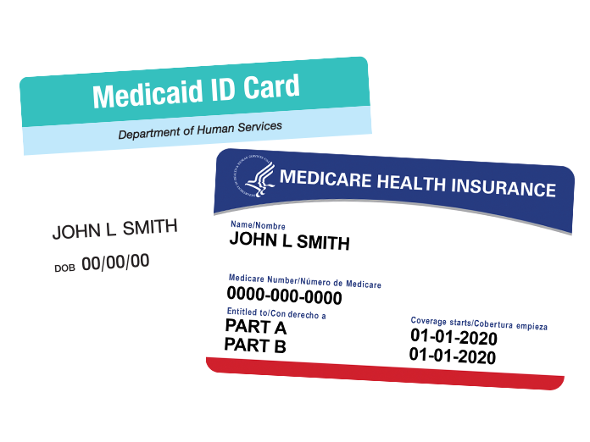
Have both Medicare and Medicaid?
You could qualify for a Dual Eligible Special Needs Plan (D-SNP).
Talk to your broker to see if you qualify for a plan
with extra benefits at low or no extra cost to you.
Notes:
{VO:} Do you have both Medicare and Medicaid? If so, you could qualify for a Dual Eligible Special Needs Plan, also known as a D-SNP. D-SNPs are specialized Medicare Advantage plans created for those who qualify for both Medicare and Medicaid. With a D-SNP, you could get extra benefits that go beyond Original Medicare. Talk with your broker to see if you qualify for an Aetna D-SNP.

Slide 19

It’s time to sign up
Notes:
{VO:} Now that you understand Medicare, it’s time to sign up.

Slide 20
Medicare Advantage plan enrollment periods
Annual Enrollment Period (AEP)
October 15–December 7
OCT
NOV
DEC
15
7
Initial Enrollment Period (IEP)
3 months before and 3 months after the month you turn 65
MONTH 1
MONTH 2
MONTH 3
BIRTHDAY
MONTH 1
MONTH 2
MONTH 3
    This timing could be different if your birthday is the first of the month. Please visit Medicare.gov for more details.
Notes:
{VO:} Generally speaking, you can only enroll in a Medicare Advantage plan during specific times of the year.
The main enrollment time is the Annual Enrollment Period (AEP). This is when anyone can enroll in or disenroll from a Medicare plan.
AEP runs from October 15 to December 7 each year. Coverage then begins January 1 of the following year.
The Initial Enrollment Period (IEP) is the 7-month period that begins 3 months before you turn 65. It also includes the month you turn 65 and ends 3 months after the month you turn 65. However, this timing could be different if your birthday is the first of the month. Please visit Medicare.gov for more details.

Slide 21





What’s in the enrollment kit?
Notes:
{VO:} You have the option to download an enrollment kit. Inside you should find:
An Informed Choices section that explains everything you need to know before choosing your plan.
A Back to basics section that explains the basics of Medicare.
The A Closer Look section provides a summary of your benefits. You can use this summary to get a general understanding of your coverage and responsibilities. It explains in general terms what Aetna covers and what you will need to pay for. Keep in mind, the Summary of Benefits doesn’t list every service or every exclusion. For specific information, you should refer to the plan’s Evidence of Coverage.
Learn about Medicare Star Ratings in the Star Ratings section.
Finally, a Rock Enrollment section to help you get started with your enrollment.

Slide 22

What are Medicare Star Ratings?
  Each year, Medicare rates all health and prescription drug plans based on a 5-star quality rating system.
  The Centers for Medicare and Medicaid Services (CMS), rates plans
  on a scale of 1 to 5 stars, with 5 stars being the highest quality. They use information from member satisfaction surveys, health plans
  and health care providers to give overall performance star ratings to
  plans. CMS Star Ratings can help you compare plans based on quality and performance. You can find Aetna® plan Star Ratings in your area by visiting AetnaMedicare.com/en/compare-plans-enroll/star-ratings.html.
Notes:
{VO:} Medicare Star Ratings let you know about a plan’s quality.
Each year, Medicare rates all health and prescription drug plans based on a 5-star quality rating system.
The Centers for Medicare and Medicaid Services (CMS), rates plans on a scale of 1 to 5 stars, with 5 stars being the highest quality. They use information from member satisfaction surveys, health plans and healthcare providers to give overall performance star ratings to plans. CMS Star Ratings can help you compare plans based on quality and performance. You can find Aetna plan Star Ratings in your area by visiting our site online.

Slide 23
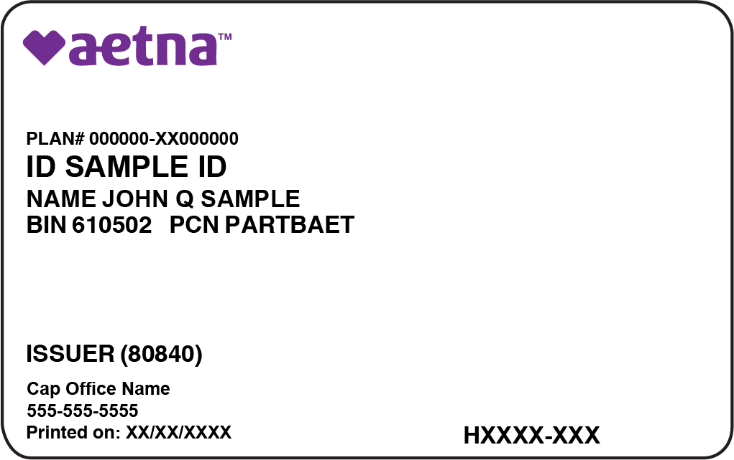
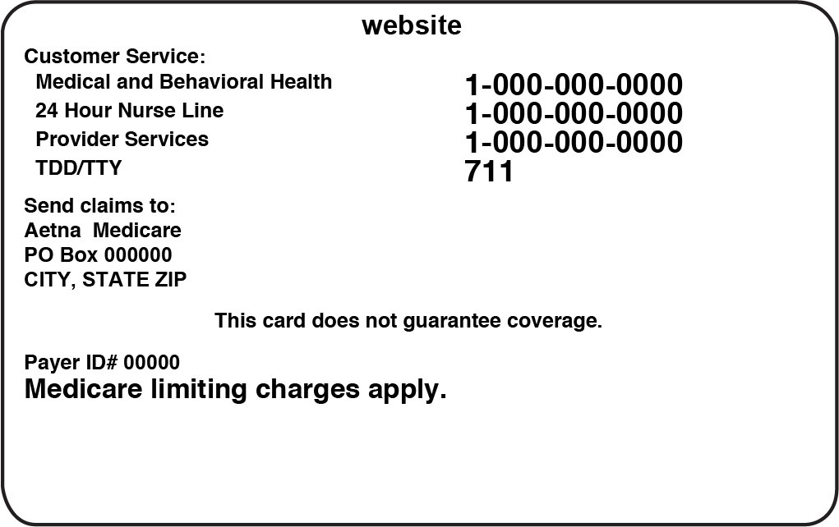
Once you’re a member, you’ll get an ID card with:
FRONT
Plan number
ID number
PCP info
Contract PBP number
BACK
Contact info
©2018 Aetna Inc.
23
Notes:
{VO:} Once you're a plan member, you'll get your ID card and occasional letters or phone calls from us and our partners. On the front of your member ID card, you can see your Plan and ID numbers, which you'll need to provide to your doctor. On the bottom left will be the contact information for you Primary Care Physician, or PCP. On the bottom right is your Contract PBP number, which you will need whenever you are using our online tools. You can also easily find important numbers for customer service and the 24/7 nurse line on the back of the card.

Slide 24

Our total
approach to Medicare

Slide 25

Thank you
Aetna Medicare is a HMO, PPO plan with a Medicare contract. Our SNPs also have contracts with State Medicaid programs. Enrollment in our plans depends on contract renewal. Plan features and availability may vary by service area. Other pharmacies are available in our network. Out-of-network/non-contracted providers are under no obligation to treat Aetna members, except in emergency situations. Please call our customer service number or see your Evidence of Coverage for more information, including the cost-sharing that applies to out-of-network services. Every year, Medicare evaluates plans based on a 5-star rating system. Aetna Medicare’s pharmacy network includes limited lower cost preferred pharmacies in: rural Missouri, rural Maine and rural South Dakota. The lower costs advertised in our plan materials for these pharmacies may not be available at the pharmacy you use. For up-to-date information about our network pharmacies, including whether there are any lower-cost preferred pharmacies in your area, members please call the number on your ID card, non-members please call 1-833-258-3132 (TTY: 711) or consult the online pharmacy directory at http://www.aetnamedicare.com/pharmacyhelp. The pharmacy network may change at any time. You will receive notice when necessary. Members who get “Extra Help” are not required to fill prescriptions at preferred network pharmacies in order to get Low Income Subsidy (LIS) copays.

